Slide 1
Introduction to BigData
Premalatha T

Slide 2
What is BigData?

Slide 3
BigData
Bigdata is a term that describes the large volume of Data.
V’s of Bigdata:
Volume
Velocity
Variety
Value

Slide 4
BigData
Volume – Scale of Data
Variety – Different forms of Data
Velocity- Speed of Data
Veracity – Uncertainity of the Data

Slide 5
BigData
Structured – RDBMS Databases( Oracle and MySQL)
Semi structured data – CSV,XML,JSON
Unstructured- Audio, Video, Image, Log files

Slide 6
Why Bigdata?

Slide 7
BigData
Process
To process huge amount of data which traditional systems are not capable of processing

Slide 8
BigData
Store
To process huge amount of data we first need to store it.
Are our traditional systems capable to store massive amount of data?

Slide 9
BigData
Are our traditional systems capable to store massive amount of data?

Slide 10
BigData System requirements
Store Huge Amount of Data
Process huge amount of data
Scale easily to accommodate growing requirements

Slide 11
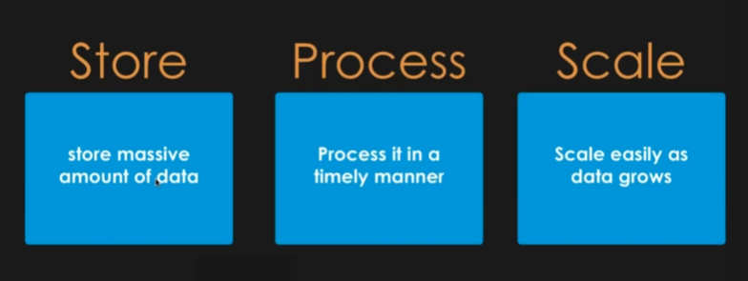
BigData

Slide 12
Two ways to build a system

Slide 13

Two ways to build a system

Slide 14

Bigdata

Slide 15
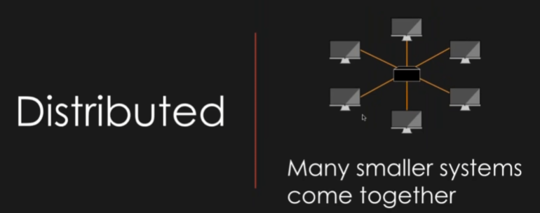
Monolithic or Distributed?

Slide 16
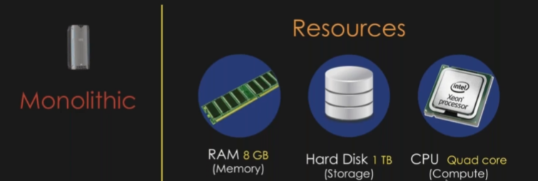
Monolithic or Distributed?

Slide 17
Monolithic or Distributed?
Is Monolithic scalable?
2 x resources is not always equal to 2x performance

Slide 18
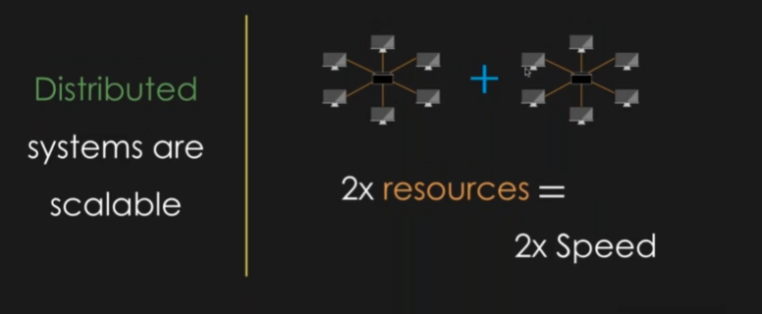
Monolithic or Distributed?

Slide 19
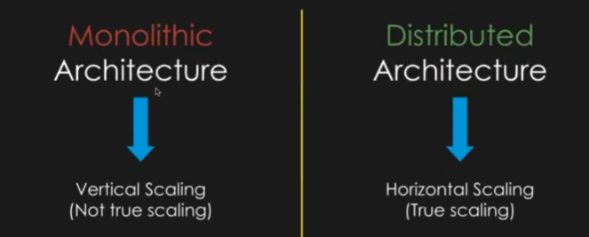
Monolithic or Distributed?

Slide 20
Why Bigdata?
That is why Big data systems are Distributed Architecture.

Slide 21
What is Hadoop?

Slide 22
What is Hadoop?
Hadoop is a framework to solve Bigdata problems.

Slide 23
Hadoop Evolution

Slide 24
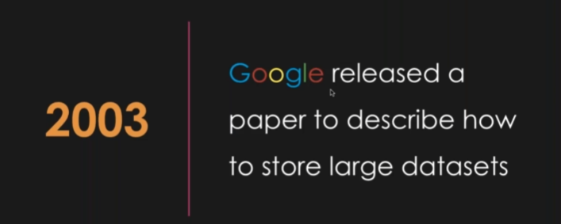
Hadoop Evolution

Slide 25
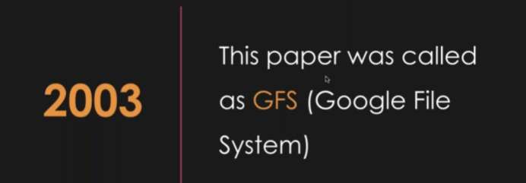
Hadoop Evolution

Slide 26
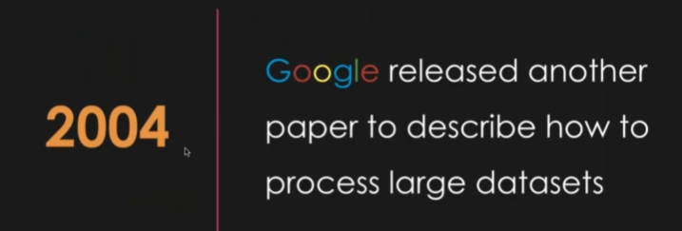

Hadoop Evolution

Slide 27

Hadoop Evolution

Slide 28
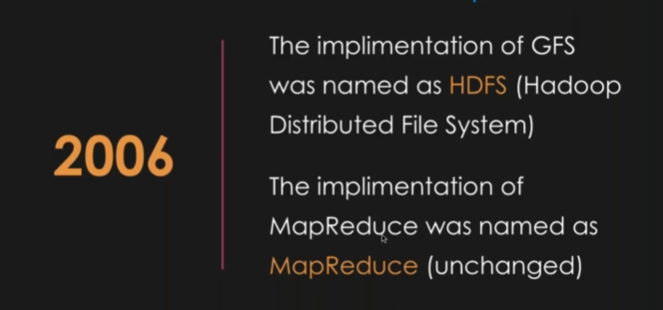
Hadoop Evolution

Slide 29
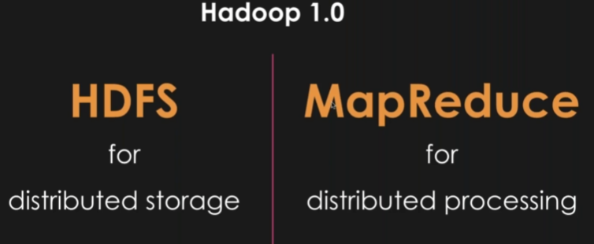
Hadoop Evolution

Slide 30
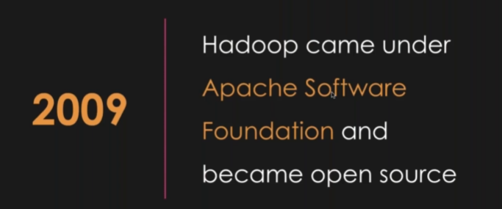
Hadoop Evolution

Slide 31
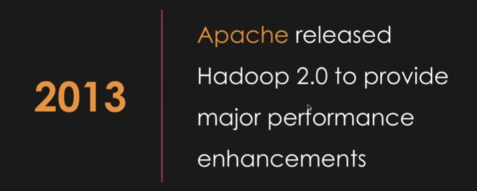
Hadoop Evolution

Slide 32
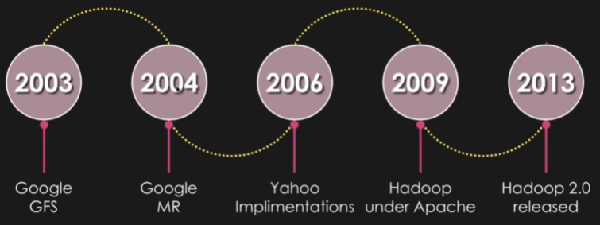
Hadoop Evolution

Slide 33
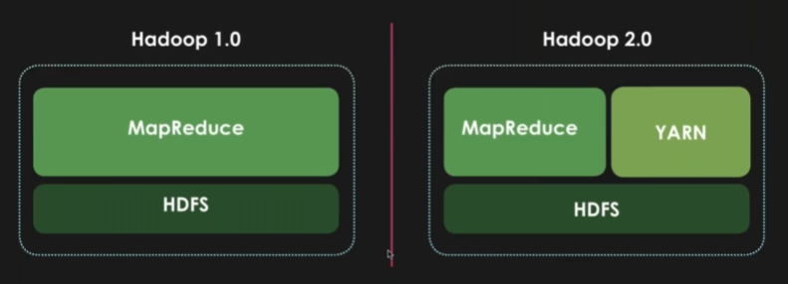
Hadoop Evolution

Slide 34
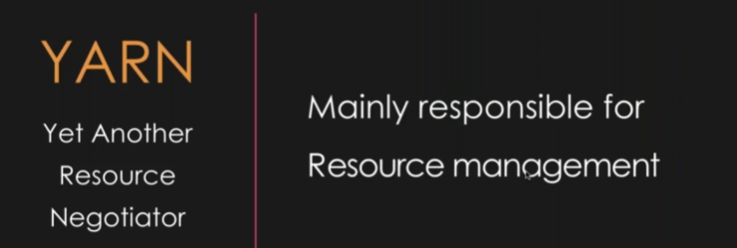
Hadoop Evolution

Slide 35
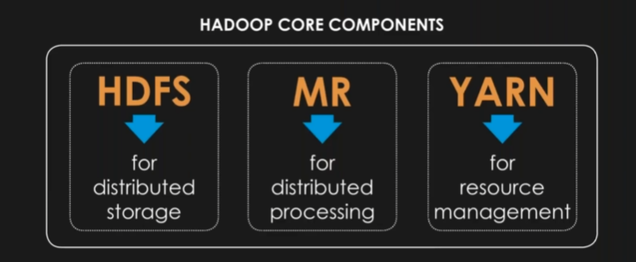
Hadoop Evolution

Slide 36
Hadoop ecosystem

Slide 37
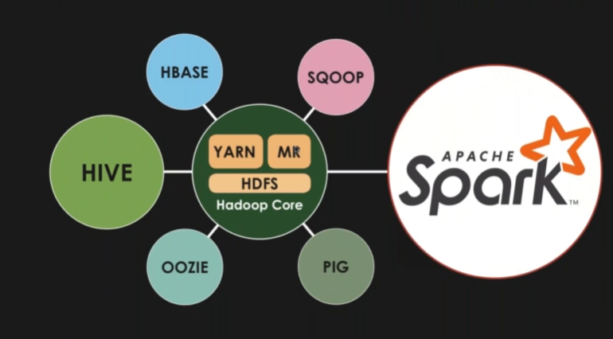
Hadoop Ecosystem

Slide 38

Hadoop Evolution

Slide 39

Hadoop Evolution

Slide 40
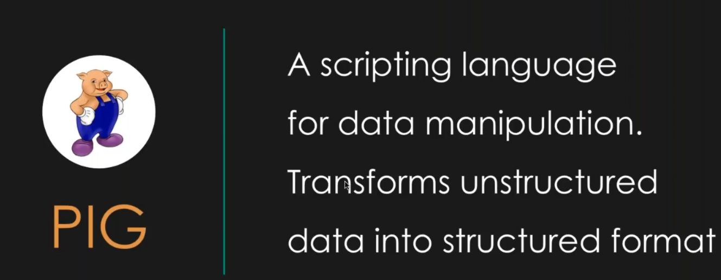
Hadoop Evolution

Slide 41
Hadoop Evolution

Slide 42
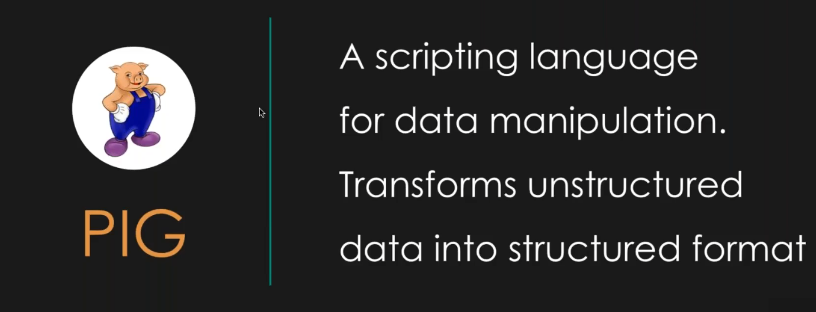
Hadoop Ecosystem

Slide 43

Hadoop Ecosystem

Slide 44
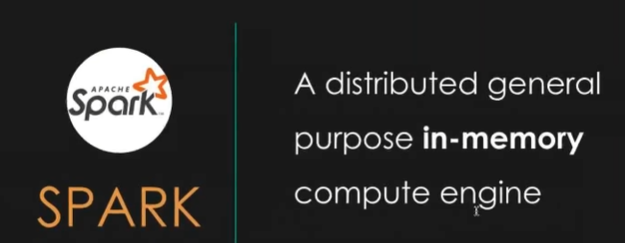
Hadoop Ecosystem

Slide 45
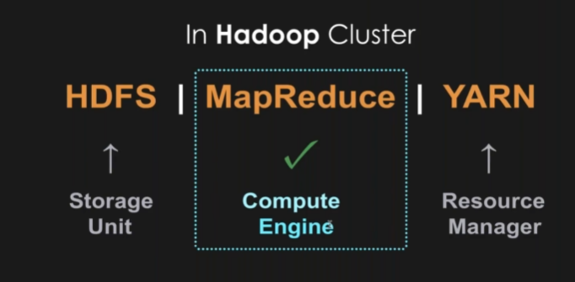
Introduction to Spark

Slide 46
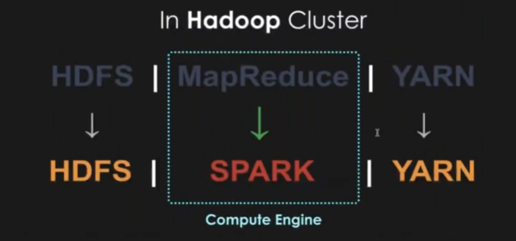
Introduction to Spark

Slide 47
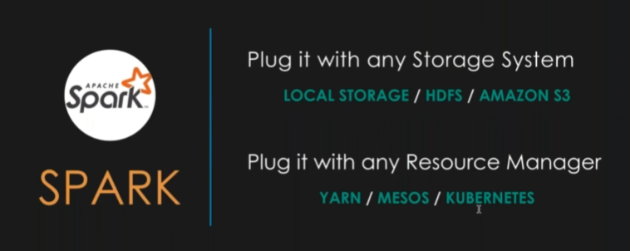
Introduction to Spark

Slide 48
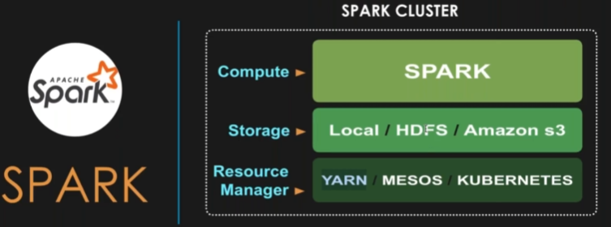
Introduction to Spark

Slide 49
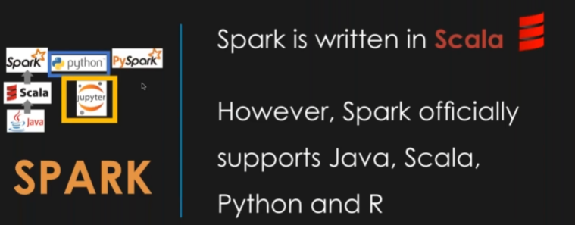
Introduction to Spark

Slide 50
HDFS Architecture

Slide 51
HDFS Architecture
Hadoop Distributed File System
Node 1
Node 2
Node 3
Node 4

Slide 52
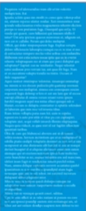
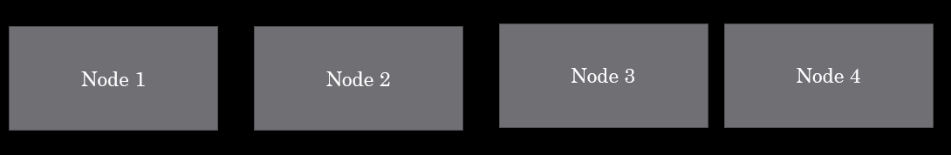
HDFS Architecture

Slide 53
HDFS Architecture
Is it a good idea to transfer that file (500 mb) to that single node?
Shall we divide into 4 parts;
Which is basically called as blocks here.

Slide 54
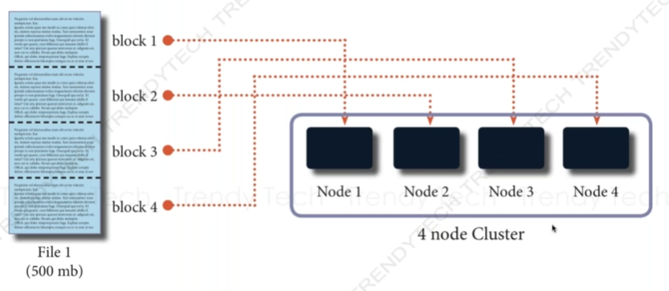
HDFS Architecture

Slide 55
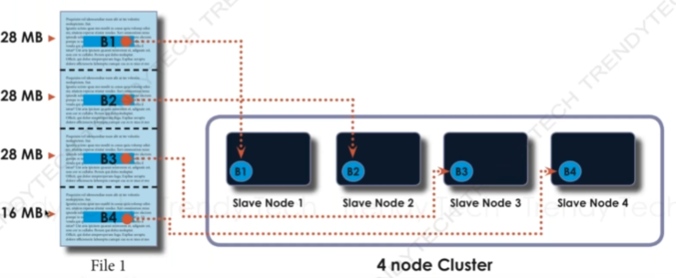
HDFS Architecture

Slide 56
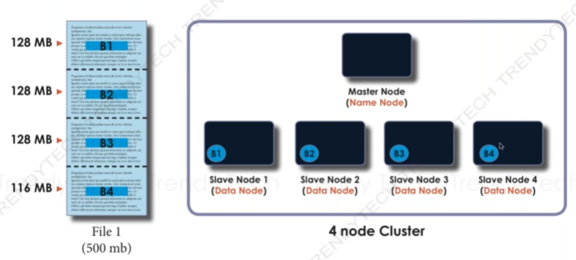
HDFS Architecture

Slide 57
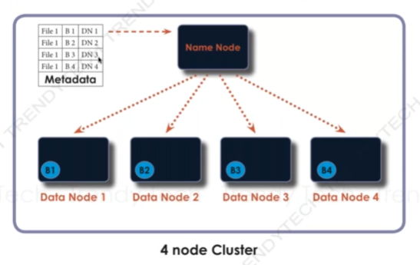
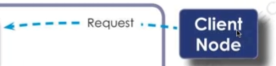
HDFS Architecture

Slide 58
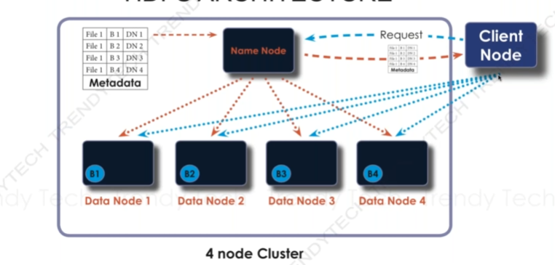
HDFS Architecture

Slide 59
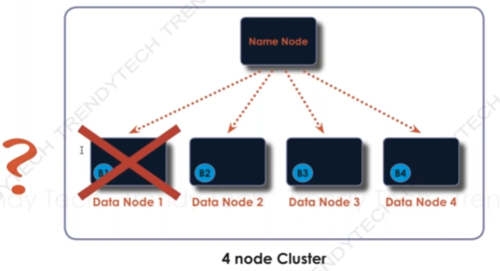
HDFS Architecture

Slide 60
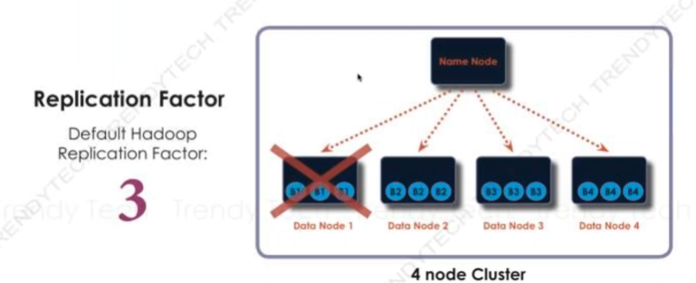
HDFS Architecture

Slide 61
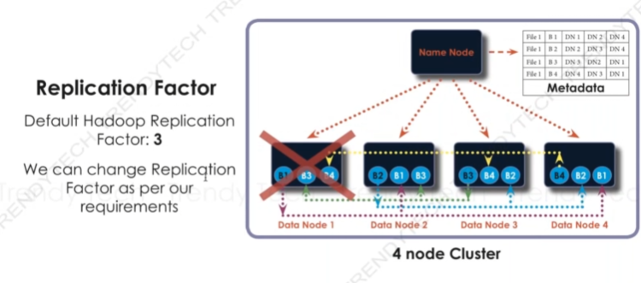
HDFS Architecture

Slide 62
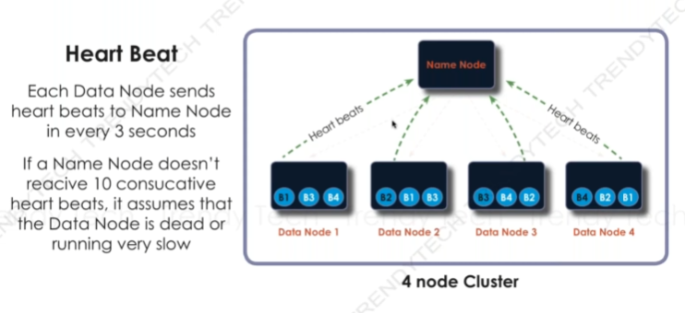
HDFS Architecture

Slide 63
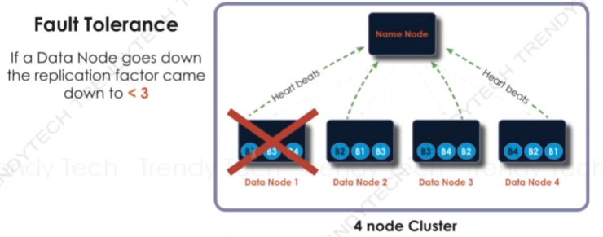
HDFS Architecture

Slide 64
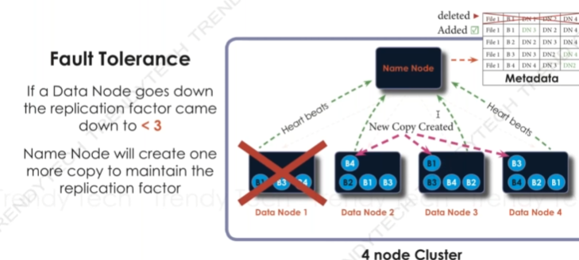
HDFS Architecture

Slide 65
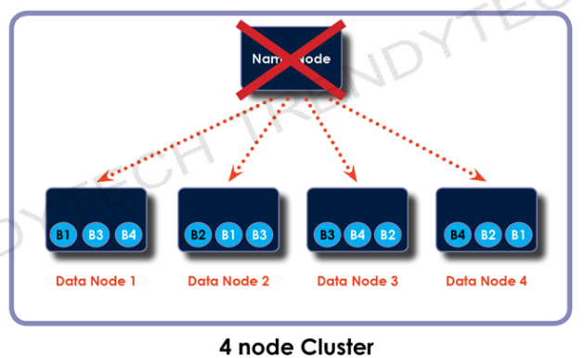
HDFS Architecture

Slide 66
HDFS Architecture
Name Node Failure - Name Node fails means no access to Metadata
No metadata means no access to cluster

Slide 67
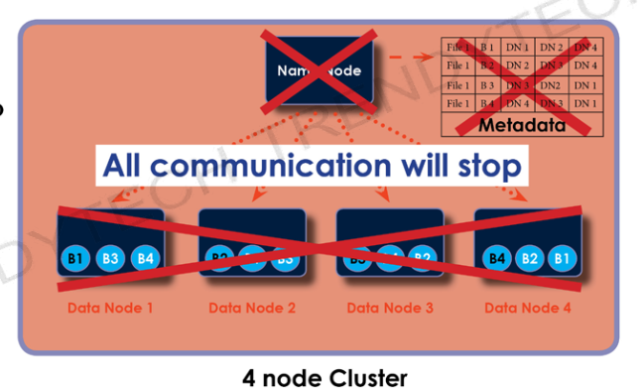
HDFS Architecture

Slide 68
HDFS Architecture
Name node is a single point of failure in Hadoopv1.
Name node is no longer a single point of failure in Hadoop v2.

Slide 69
HDFS Architecture
Name node Failure:
Name node is a single point of failure in Hadoop v1.
Name node is no longer a single point of failure in Hadoop v2.

Slide 70
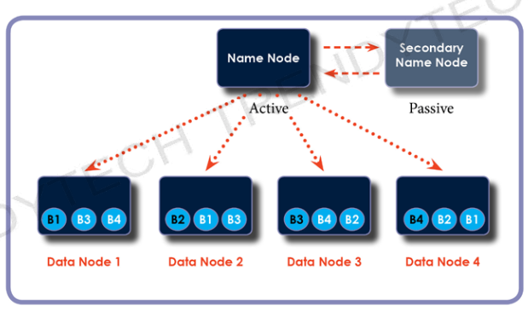
HDFS Architecture

Slide 71
HDFS Architecture
Two important Metadata files
1) FSimage
2)Edit logs

Slide 72
HDFS Architecture
FS image- Snapshot of the file system at a particular time.
Edit logs: Transaction logs that changes in the HDFS file system

Slide 73
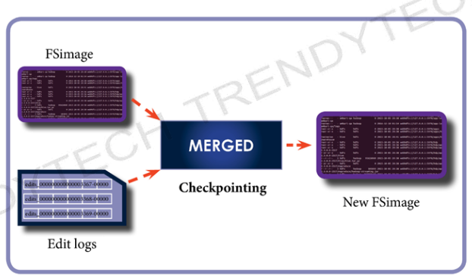
HDFS Architecture

Slide 74
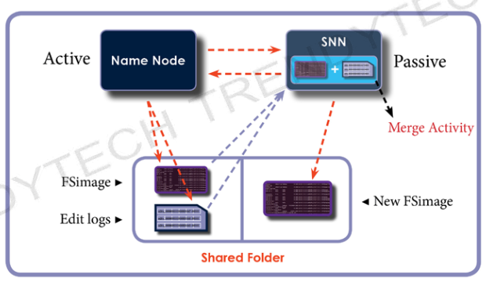
HDFS Architecture

Slide 75
HDFS Architecture
Name Node Recovery:
Secondary NameNode performs FSimage and Edit logs merging to get new updated Fsimage.

Slide 76
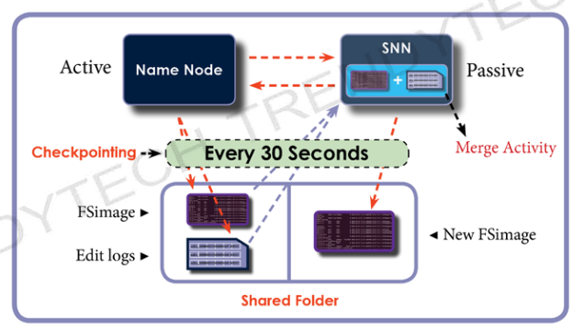
HDFS Architecture

Slide 77
HDFS Architecture
Secondary Name Node performs FSimage and Edit logs merging to get new updated FSimage.
This process repeats after every 30 seconds.

Slide 78
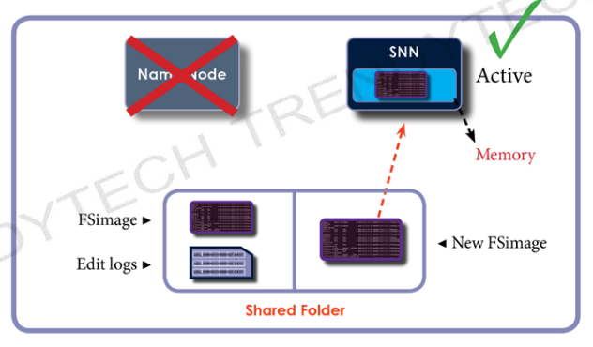
HDFS Architecture

Slide 79
HDFS Architecture
Primary Name Node Failure:
The secondary name Node becomes active Name Node.This becomes active Node.
Responsibility of Hadoop Admin to introduce a new Secondary Name Node.

Slide 80
HDFS Architecture
Understanding replication Factor:
Each data block in Hadoop has 3 replicas.
Replicas are stored in different locations.
The replica locations are also updated in Metadata stored in the Name Node.

Slide 81
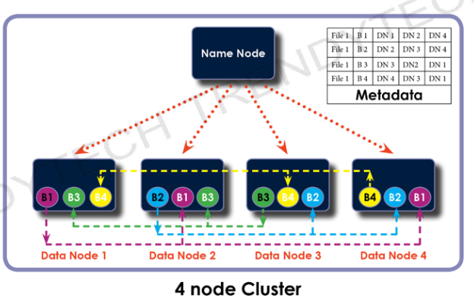
HDFS Architecture

Slide 82
HDFS Architecture
How replicas are placed?
Rack means group of systems placed in different geographic locations.

Slide 83
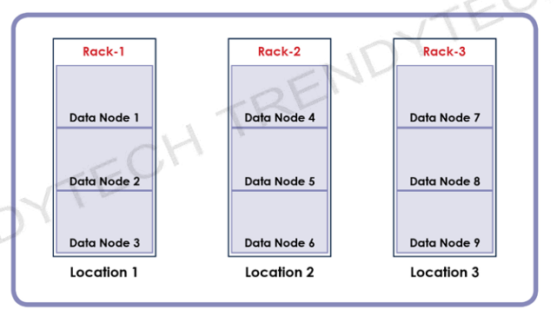
HDFS Architecture

Slide 84
HDFS Architecture
Replica Pipeline
Replicas of data block are forwarded to new locations.
Forwarding data blocks requires large amount of network band width.
Involves more input-output operations.

Slide 85
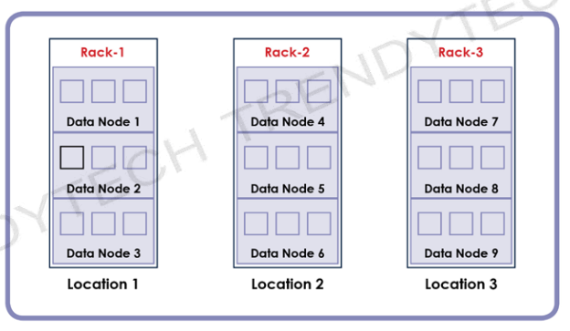
HDFS Architecture

Slide 86
HDFS Architecture
Name Node stores data block in a data node of a rack.

Slide 87
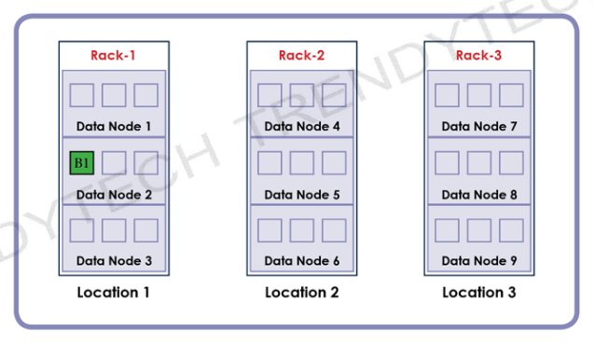
HDFS Architecture

Slide 88

HDFS Architecture

Slide 89
HDFS Architecture
Replica Pipeline
Replicas of data block are forwarded to new locations.
Forwarding data blocks within the same rack requires small amount of network bandwidth.
Involves less input-output operations.

Slide 90

HDFS Architecture

Slide 91
HDFS Architecture
Rack Failure
If we place all replicas in a single rack, there are high chances of data loss if the rack goes down.

Slide 92

HDFS Architecture

Slide 93
HDFS Architecture
Choosing Multiple Racks:
Each Replica placed in different rack is not an ideal solution

Slide 94

HDFS Architecture

Slide 95
HDFS Architecture
Rack Awarenesss Mechanism:;
The balanced approach is to place replicas in two different rack or vice versa.

Slide 96
Installation of Cloudera

Slide 97
HDFS Architecture

Slide 98
HDFS Architecture

